Slide 1


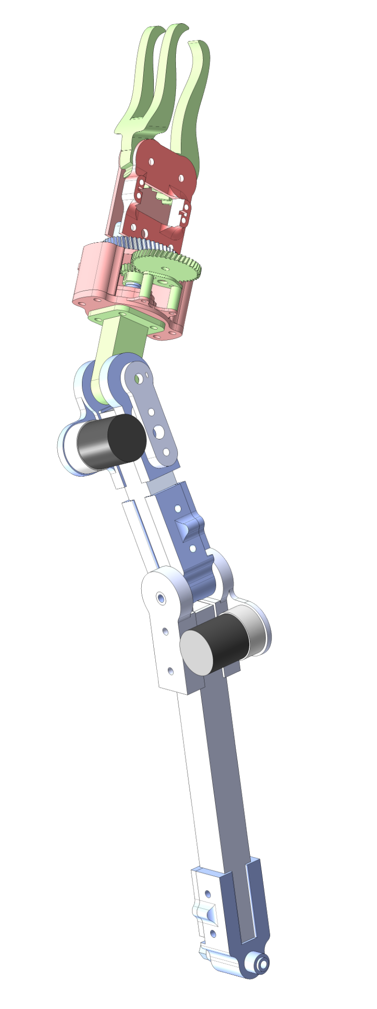
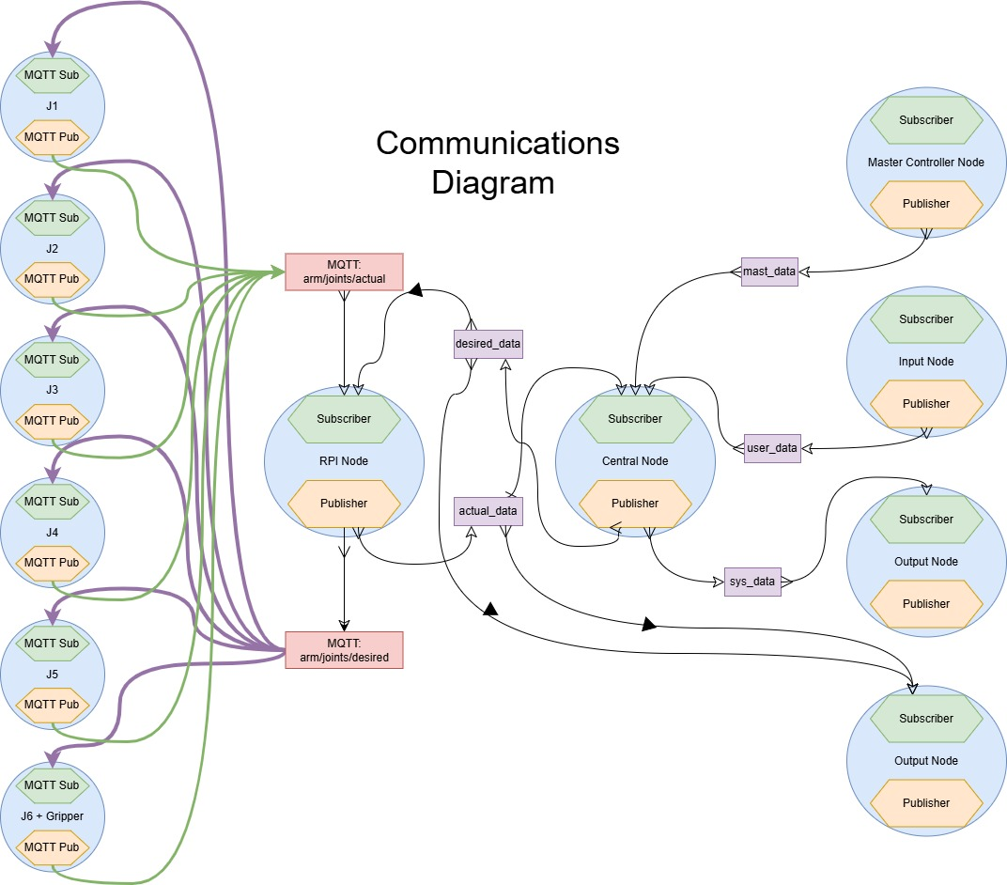
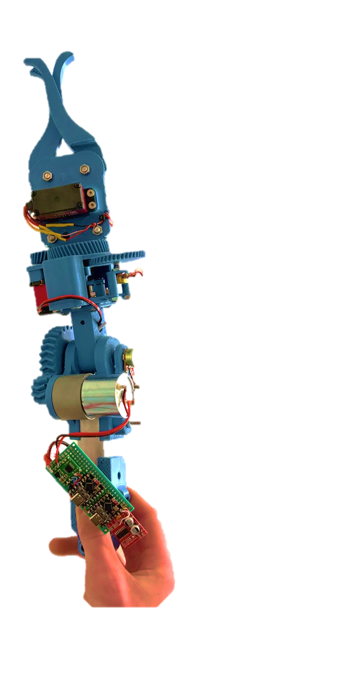
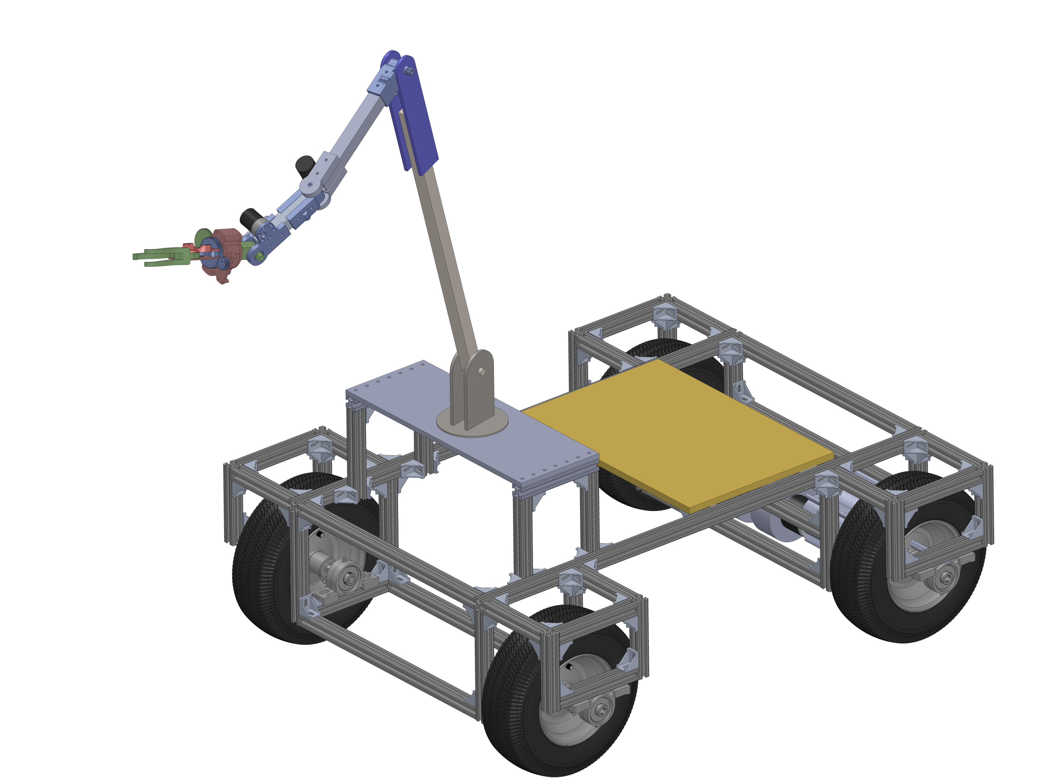
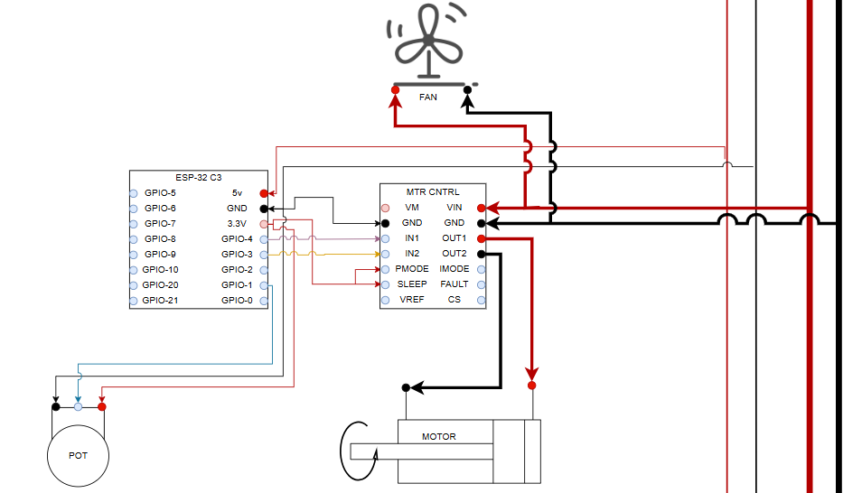
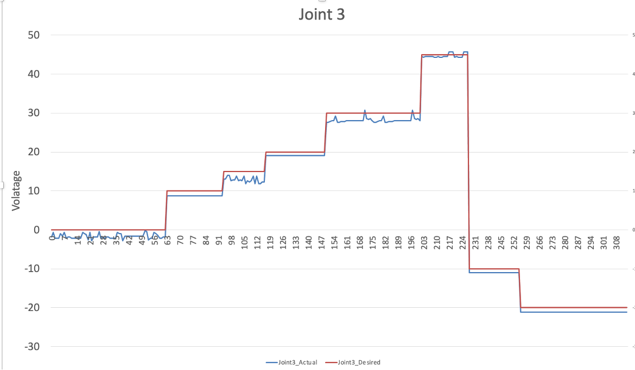
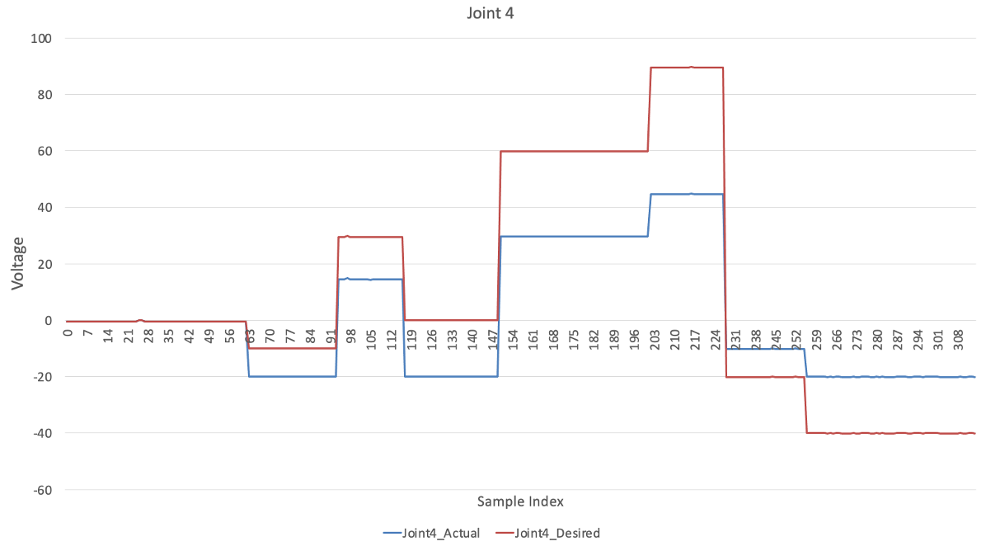
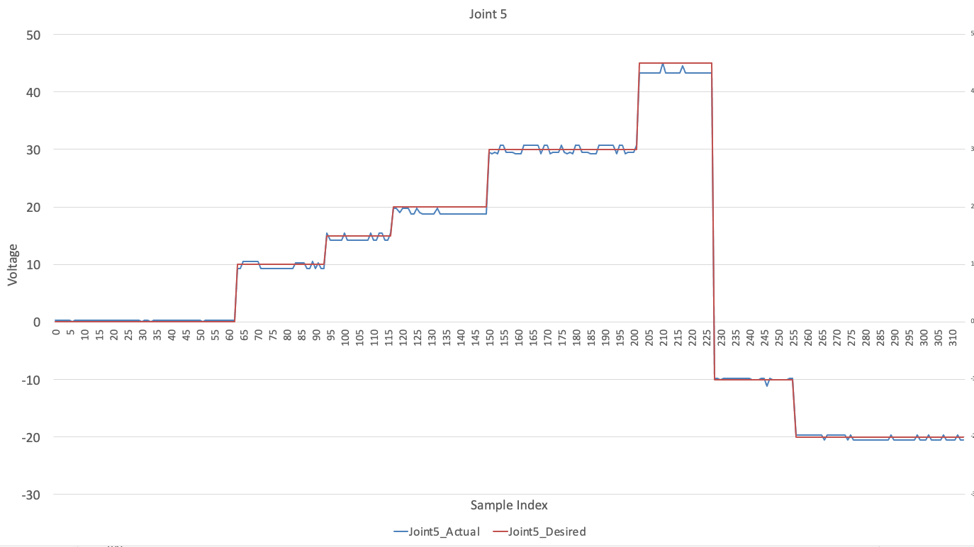
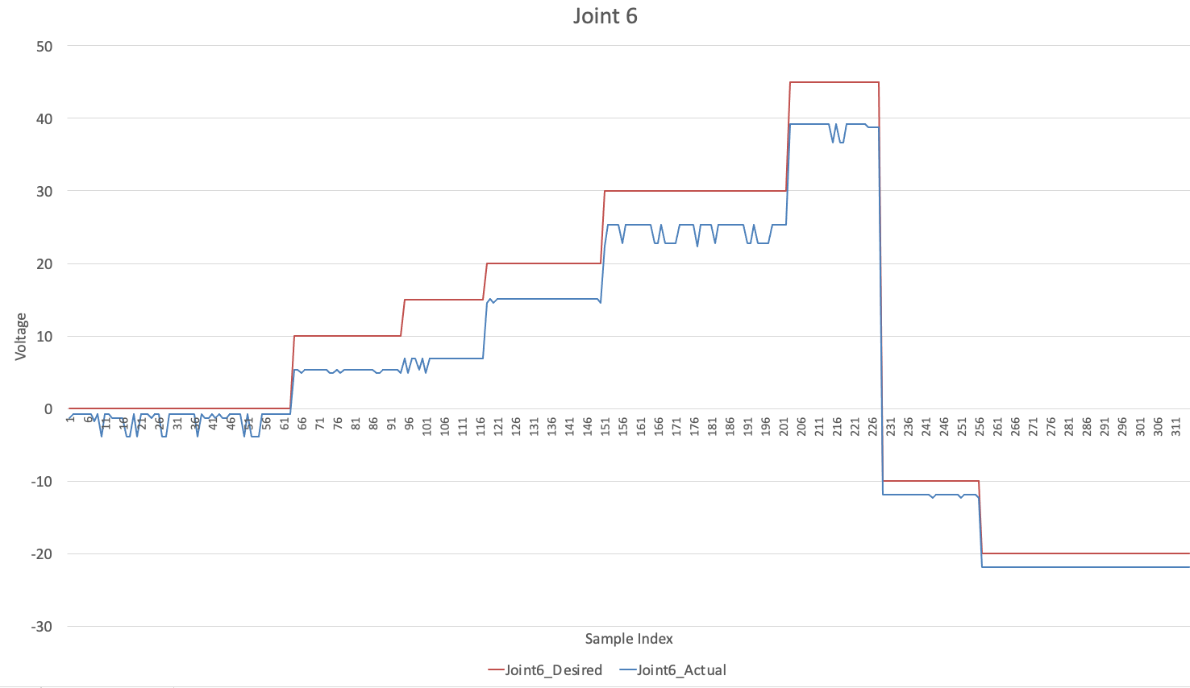
LuMAR – Lunar Maintenance Autonomous Robot
Team 30: Eddie Larkin, Jordan Laws, Nhung Nhan, Gill Saligman
Advisor: Dr. Ajmal Yousuff
Challenges
Current lunar rovers lack modularity, autonomy, and versatility for long-term infrastructure servicing, which requires an abundance of human intervention. NASA wants a robot that can complete various servicing tasks semi-autonomously capable of seamless integration.
Department of Mechanical Engineering and Mechanics
Electronics & Software
End effector
PLA
Interchangeable
Servo
0 to 100 °
Objective
Design a modular lunar servicing robot featuring a chassis, a complex robotic arm, and an intuitive arm controller.
Grasp, lift, and transport payloads
Joint 6​
PLA ​
Axial Joint​
Controlled by servo modified into a motor ​
-180° to 180°
​
Stakeholders
NASA & Space Agencies – Potential end users funding and supporting lunar base development .
Astronauts & Lunar Base Crew – Beneficiaries who rely on robotic support for maintenance and safety.
Aerospace & Robotics Engineers – Designers, developers, and operators of robotic systems.
Government & Policy Makers – Regulators overseeing space exploration and infrastructure.
Joint 5
Aluminum + PLA
Radial Joint
Controlled by Motor and POT
-70° to 70°
Joint 4
Aluminum + PLA + ABS
Radial Joint
Controlled by Motor and POT
-70° to 70°
Electronic Mounting Board
12v 40APower Supply for Drivetrain
24v 20A Power supply for Arm
Raspberry Pi 4
Buck Converter 24v to 5V
To power RPI and LV Arm Line
Drivetrain Motor Controllers and DPDF Relays
Communications
Based around the central node that’s running on the operator's computer.
The node filters inputs from the user or the controllers and sends commands to a Raspberry Pi (RPI) running on the robot.
The RPI hosts a Wi-Fi network connecting to ESP32 modules on each joint, which continuously receive angle positions.
Each ESP32 uses a potentiometer to track the position of the joint and runs a PID loop to reach the target angle, while sending real-time feedback to the RPI.
Transmitted data example: [J1,J2,J3,I4,J5,J6,Grip], each ESP will parse the position that corresponds to its joint.
Authentic Prototype
Robot Chassis
Constructed from aluminum extrusion and brackets
Modular/moveable electronics and arm
Robust hub carriers
Modular detachable arm brackets
Wide Base increases stability
Gearbox and CIM Motors
Electronics
Joint contents:
ESP-32
Polulu Motor Driver
Potentiometer
Motor and Fan
Running a HV and LV line up the arm reduces wiring complexity while maintaining modularity, allowing for easy joint removal.
Approach
To enhance adaptability, the end effector is interchangeable, enabling the robot to switch tools depending on the task at hand.
The six-degrees-of-freedom (DOF) arm provides a wide range of motion, allowing precise and efficient execution of complex tasks in a lunar environment.
Integrate a modular electrical architecture and utilize an ROS2 communication pipeline for seamless operation.
Evaluate load and torque requirements for each joint and implement appropriate gearing ratios to prevent exceeding torque limits.
Maintain modularity and reliability for adaptability in lunar conditions.
Data
Single Joint Wiring Schematic
Interpret Data
Each joint is set to the same angle and gathered data for approximately 5 seconds of its actual position.
The data graphs illustrate the robot’s actual joint positions compared to the commanded (input) positions over time.
Acknowledgement
NASA, “2025 RASC-AL Competition Guidelines,” National Institute of Aerospace, 2025. [Online]. Available: https://rascal.nianet.org/wp-content/uploads/2025-RASC-AL-Competition-Guidelines.pdf.
2.5” CIM Motor Specifications Sheet, https://cdn.andymark.com/media/W1siZiIsIjIwMTgvMTEvMjcvMDkvMzUvNDIvMWE5MjRiNzUtNjA2ZC00YjIxLTk4ZTItNGEzMTY4ZGM1Mzc4L0NJTS1tb3Rvci1jdXJ2ZS1hbS0wMjU1LnBkZiJdXQ/CIM-motor-curve-am-0255.pdf?sha=0a37bf0745d8074e

